Slide 1
Warehouse management SYSTEM
Department of CSD
PRESENTED BY PALAKURI SWAMY
ROLL NO. 20K91A6730
GUIDE MS.SANTHOSHI MAM
HOD Dr.V.KRISHNA

Slide 2
Plan of action
Problem Analysis, Information Gathering 10Days
Database design 7Days
Application code writing 15Days
Code Implementation 6Days
Error checking 5Days
Connecting database to the application 4Day

Slide 3
CONTENT :
Introduction
❖ Objectives
❖ Problem statement
❖ Existing system
❖ Proposed system
❖ Literature Survey
❖ Requirements(hardware & software)
❖ System Architecture
❖ Methodology and Technology Specification
❖ Implementation
❖ Output
❖ Conclusion
❖ Future work
❖ Reference

Slide 4
Modules
ADMIN MODULE
EMPOLYEE MODULE

Slide 5
INTRODUCTION :
In manufacturing companies, companies produce/process raw materials into finished goods. Raw materials obtained from suppliers will be stored, to meet the production needs. A warehouse as a place to store goods requires data accuracy for every transaction of goods that exist.
A warehouse is a facility in the supply chain to consolidate products to reduce transportation costs, achieve economies of scale in manufacturing or in purchasing or provide value-added processes and shorten response time.
Warehouse has many operations or transactions with some general pattern of material flow, and typical warehouse operations include: receiving, putting away, internal replenishment, order picking, accumulating and sorting, packing, cross-docking, and shipping.

Slide 6
Problem statement :
❖To design a database and a web application to maintain records of a warehouse activities .
❖ To override the problems prevailing in the practicing manual data.

Slide 7
Objectives:
❖To give information of warehouse product details.
❖That there is a continous supply of products in warehouse.
❖To avoid the understock.
❖To overcome the problems of existing systems

Slide 8

Existing system
The existing system for data warehouse management needs much human effort that leads huge number of employees to work for hours together. The stored data can be insecure as they are physical hard copies and if their access is not strictly restricted, it creates a great chance of forgery.

Slide 9
disadvantages
Many processes are integrated into a system an error in one place entails errors in others.
Risk of choosing incorrect parameters before use.
Granting unsuitable levels of authorization to employees within the system.
Potentially unsuccessful implementation.

Slide 10

Proposed system
The proposed system is completely digitalized. This not only decreases the expenses but also decreases the percentage of active labor required for the purpose of warehouse management. This new system promises high security of the data as it allows only the selected few to access and manipulate the data.

Slide 11
advantages
Reduce human errors
Storage facility
Enhance safety
Cost-effectiveness
Enhanced risk management
Information management
Smooth movement of goods
Track of input and output

Slide 12
Literature survey
SITE |  | AUTHOR | DESCRIPTION
1. | https://www.sciencedirect.c om/science/article/abs/pii /S0959652619340600 | Mohammadehsan Torabizadeh | The performance of a sustainable warehouse management system is a multidimensional concept based on the triple bottom line approach.
2. | https://link.springer.com/ar ticle/10.1007/s11277- 017-5199-7 | Jia Mao | With the continuous development and application of information technology in the logistics industry, mobile applications, bar code, wireless communication, system integration and other technologies are widely used in warehouse management.
3. | https://www.sciencedirect.c om/science/article/pii/S2 212827115012019#! | Anas M. Atieh | This study investigates the impact of a warehouse management system on supply chain performance that provides less resources effort, more efficient, and reliable inventory management system.

Slide 13
CONT…
 | SITE | AUTHOR | DESCRIPTION
4. | https://www.tandfonline.com/doi /abs/10.1080/00207543.2017 .1394592 | C.M.k Lee | This study investigates the impact of a warehouse management system on supply chain performance that provides less resources effort, more efficient, and reliable inventory management system
5. | https://www.tandfonline.com/aut hor/Wang%2C+Hongwei | Wang, Hongwei | This paper proposes a digital warehouse management system (DWMS) in the tobacco industry based on radio frequency identification (RFID) technology.
6. | https://link.springer.com/book/1 0.1007/978-3-540-35220-4 | Michael Hompel | Although the term warehousing raises negative images like high costs and non-value-adding times, in practice most branches are bound to store their goods for various reasons.

Slide 14
Database Architecture :
Retrive
insert
ADMIN
update
DATA BASE
interface
delete
Empolyee
alter
view

Slide 15
ER diagram :
Email
Email
password
Name
Name
password
Manages
Admin_login
Employee_login
phone
phone
Gender
Gender
Manages
Product_id
Product
Product_name
Price
Quantity

Slide 16
DATA FLOW DIAGRAM :
Putway
Receiving
Storage
Warehouse mangement
Shipping
Picking
Packing

Slide 17
Methodology and Technology Specification :
Software Requirements :
HTML & CSS (Client side)
PHP (server side)
Apache (webserver)
Database (MYSQL)
Hardware Requirements:
System(64bit )

Slide 18
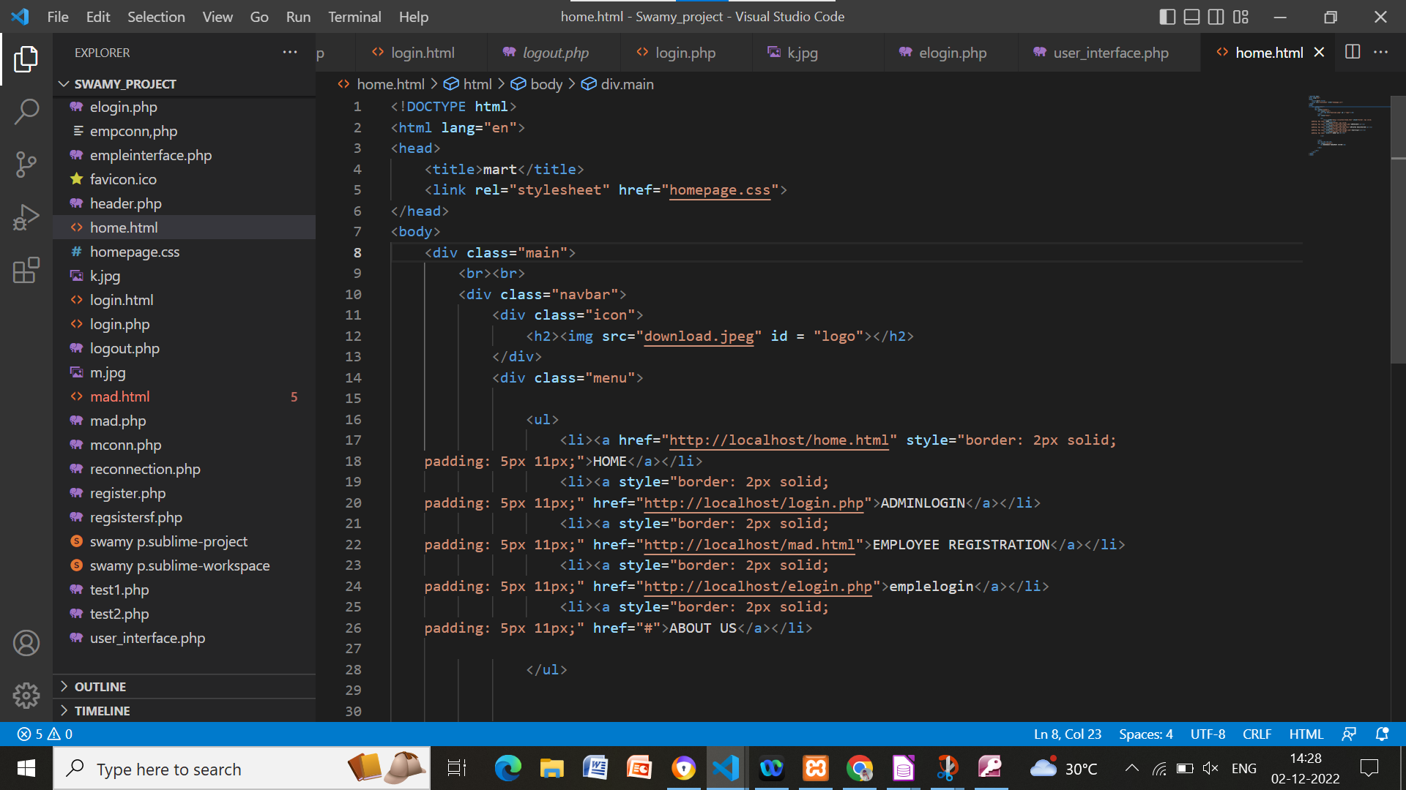
Implemention:

Slide 19
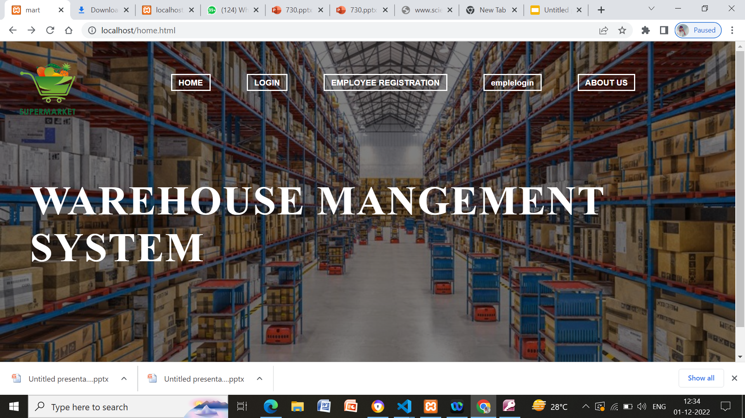
Screenshorts:

Slide 20
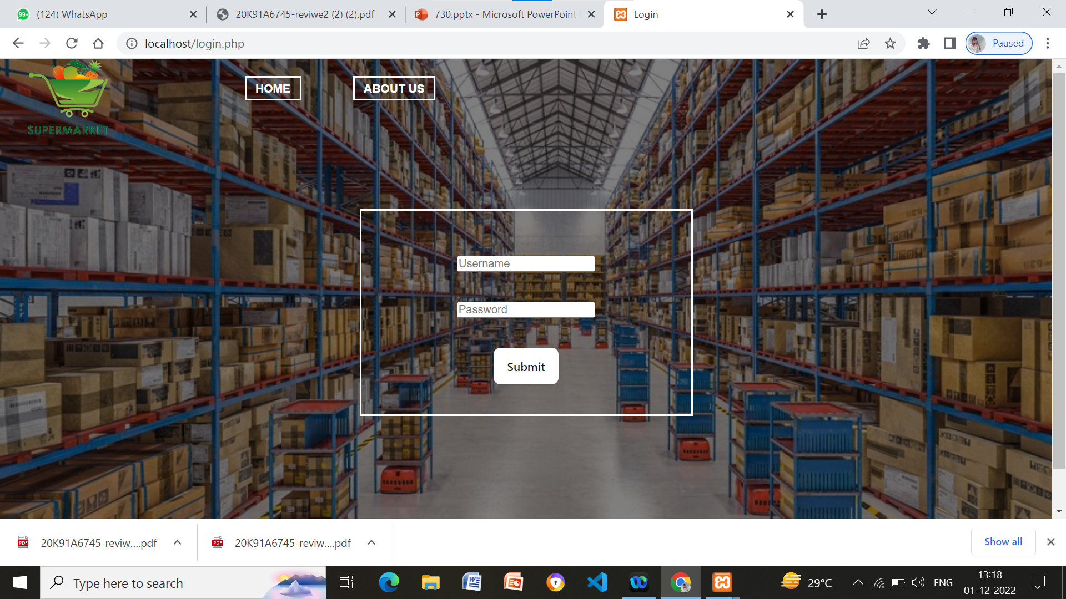
Output :

Slide 21

Cont..

Slide 22
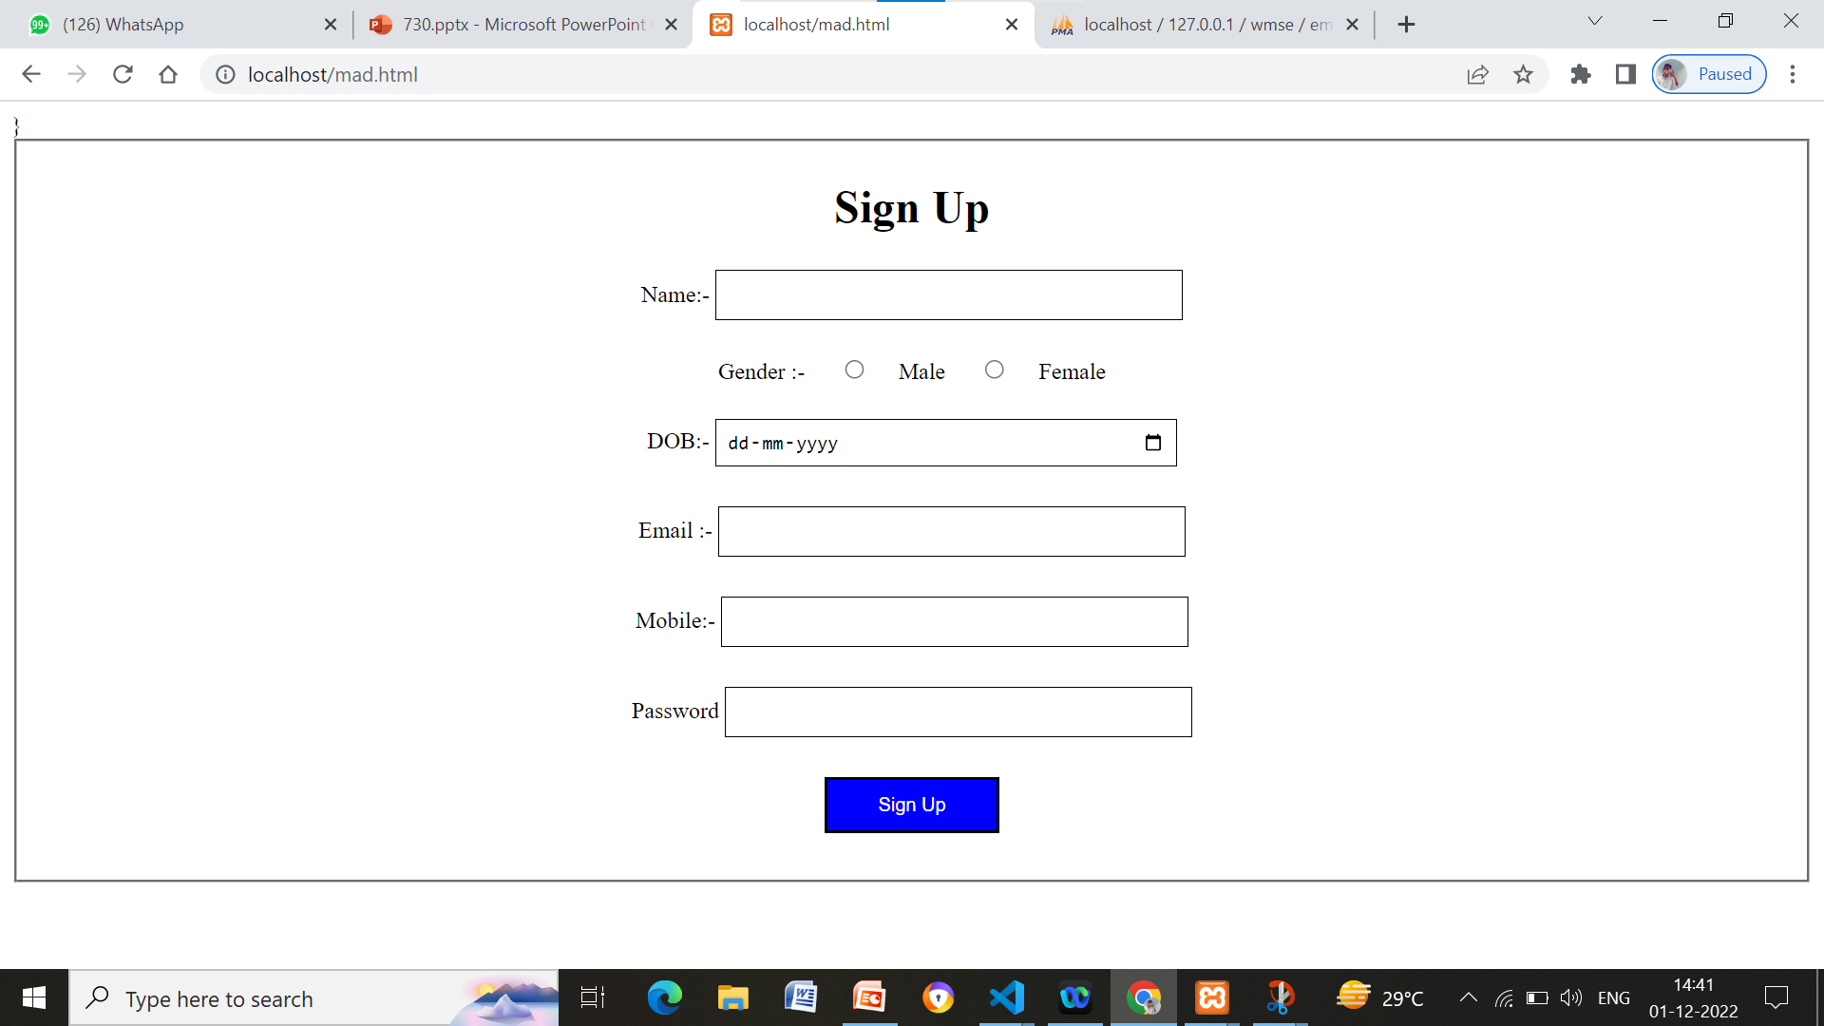

Slide 23



Slide 24
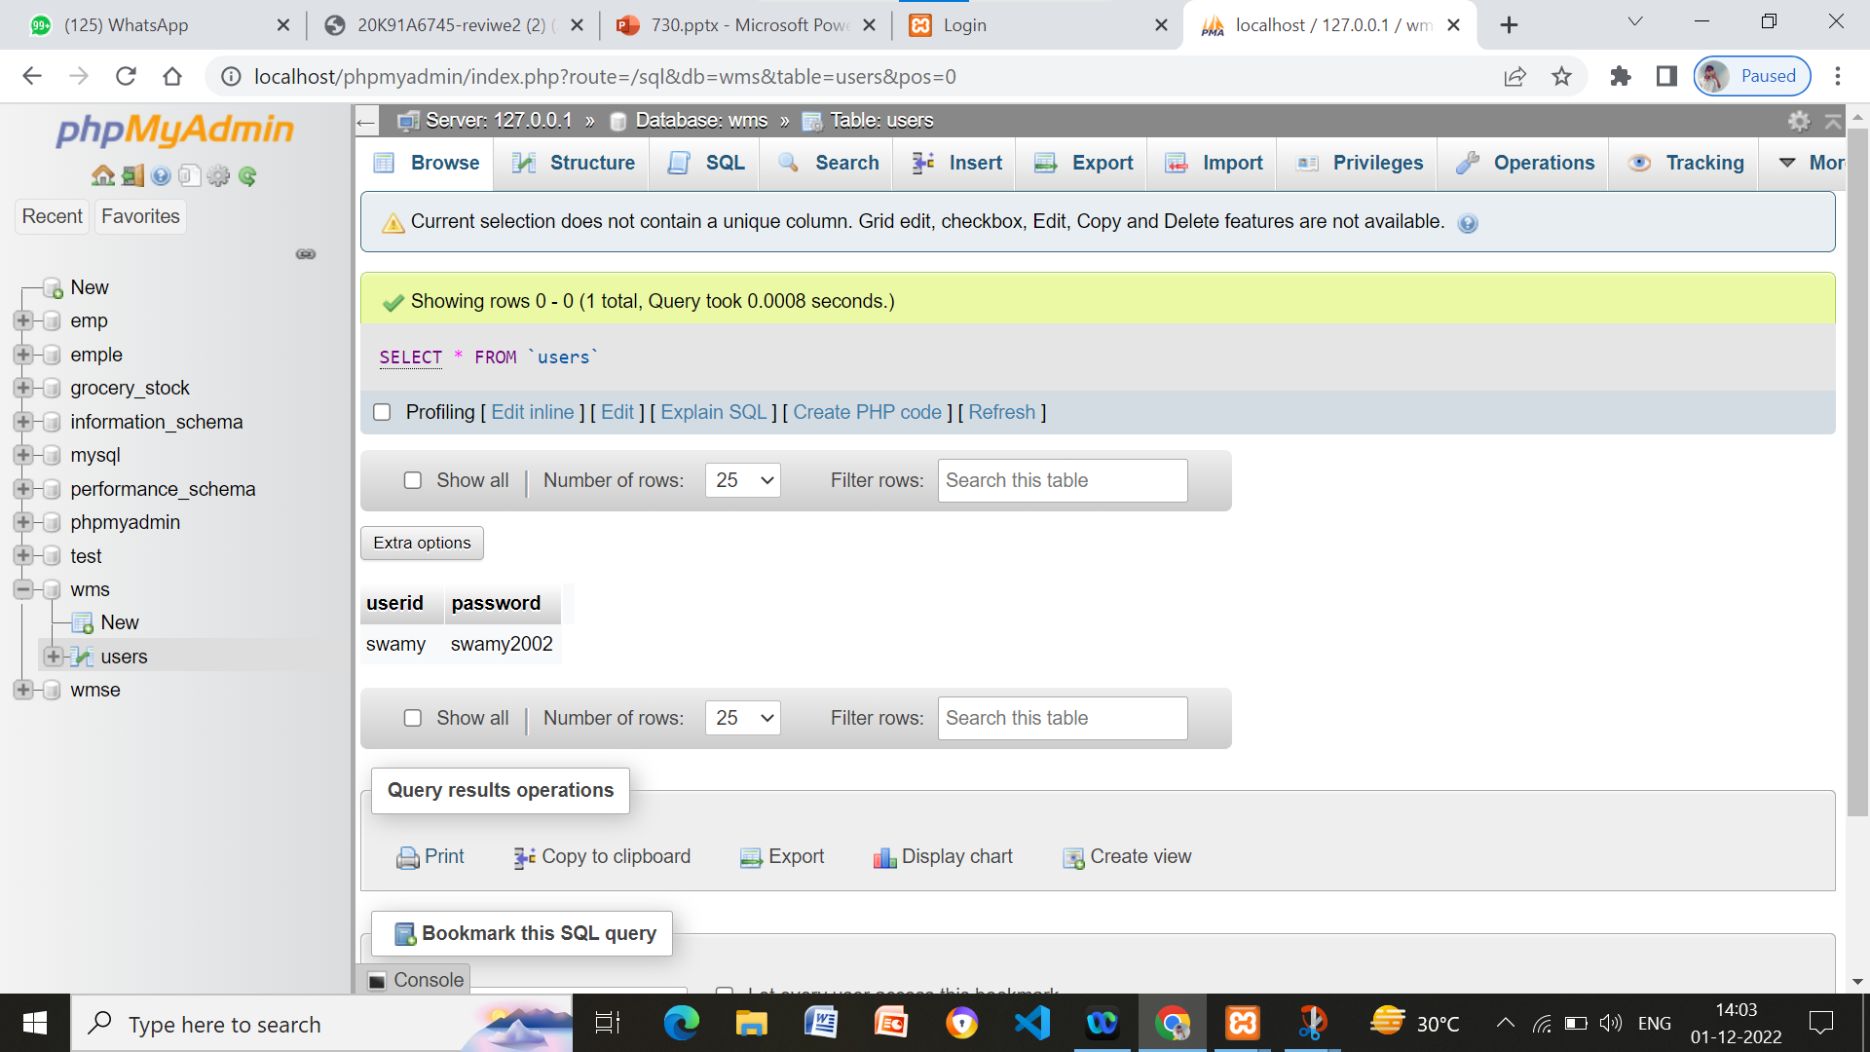

ADMIN DATABASE:

Slide 25
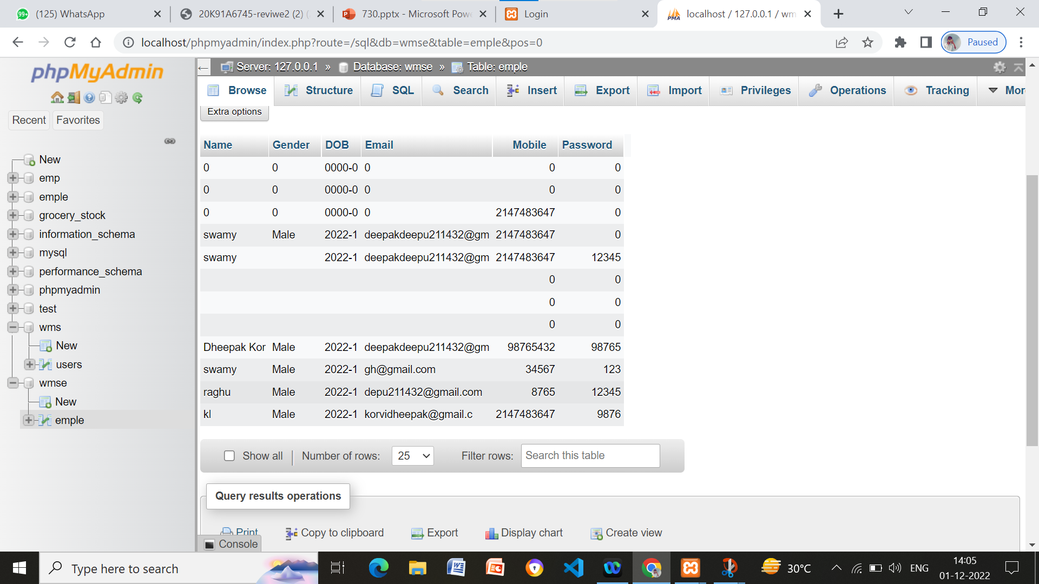
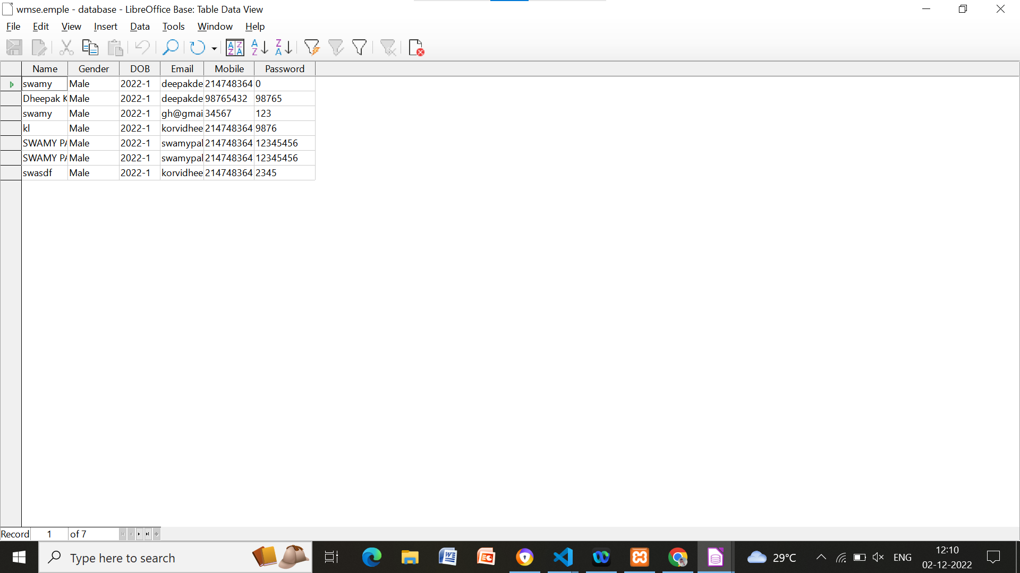
EMPOLYEE DATABASE:

Slide 26
Conclusion :
In warehousing management, existing transaction data is required for accuracy and speed in processing using a system.
Warehouse management system is an essential replacement for a manual management system. The main purpose of automating the warehouse system is to control the movement and storage of the products, together with the benefit of enhanced security and quicker handling.
Currently, the stored data can be organized according to the serial number, activated easily assuring the FIFO concept, and handed to the dealers accurately with the least amount of possible errors.
Warehouse Management System is now a necessity because it can improve warehouse efficiency and accuracy, thus providing solutions to problems that exist in the warehouse.
And also the warehouse system has become more reliable and efficient after the automation, simplifying the process for the operators, the supplier, and the dealers

